Slide 1
Introduction to
Python For Data Science
April, 2018

Slide 2
Questions?
Functions
Methods
Packages and modules
NumPy

Slide 3
Checkpoint
Some helpful resources:
List of all functions:
https://docs.python.org/3/library/functions.html
Official Python Docs:
https://docs.python.org/3/index.html
Free eBook : O’REILLY’s A WhirlWind Tour of Python:
http://www.oreilly.com/programming/free/a-whirlwind-tour-of-python.csp
Python Beginners Guide Wiki:
https://wiki.python.org/moin/BeginnersGuide/Programmers
Google (or bing)

Slide 4
Exercise 1
How many arguments does hex() require, and how many are optional?

Slide 5
Exercise 1
How many arguments does hex() require, and how many are optional?
1 Required , 0 Optional (Exactly 1 argument)
help(hex)
Help on built-in function hex in module builtins:
hex(number, /)
Return the hexadecimal representation of an integer.
hex(12648430)
'0xc0ffee'
?hex
Signature: hex(number, /)
Docstring:
Return the hexadecimal representation of an integer.
hex(12648430)
'0xc0ffee'
Type: builtin_function_or_method

Slide 6
Exercise 2 (Code Along)
Write 1 python statement to print the max between:
The length of a newly created sorted list of [1,4,6,8]
The Integer value of the String ‘3’
(Expected output is 4)

Slide 7
Exercise 2 (Code Along)
Write 1 python statement to print the max between:
The length of a newly created sorted list of [1,4,6,8]
The Integer value of the String ‘3’
(Expected output is 4)
print(max(list([len(sorted(list([1,4,6,8]))),int('3')])))

Slide 8
Exercise 3
Which of the following statements use functions and which use methods?
min([3,5,False])
list([3,5,”True”]).index(True)
x=7
x.bit_length()

Slide 9
Exercise 3
Which of the following statements use functions and which use methods?
min([3,5,False]) ← Valid , Function Calls Only
list([3,5,”True”]).index(True) ← Valid, Error, Function and Method Calls
x=7 ← Valid, No calls, just assignment
x.bit_length() ← Valid, Method Call Only

Slide 10
Checkpoint
Use the help() function for function … help!
Functions take input parameters and return an object
Input and return types don’t have to be the same
You can nest function calls
i.e. A function can be an argument to another function
As long as inner calls return a type compatible with outer call’s input parameters
Function: collection of code to perform a certain function:
Called explicitly with input parameters
Can optionally return data (otherwise returns None)
Method: Collection of code to perform a certain function:
Called on a specific object
Can access other class attributes (Don’t worry about that now)
You can define your own Functions and Methods!

Slide 11
Exercise 4 (Code Along)
Write a function my sum that takes 2 integers and prints out their sum

Slide 12
Exercise 4 (Code Along)
Write a function my sum that takes 2 integers and prints out their sum
def mysum(x,y):
print(x+y)
mysum(4,6)
Questions:
What happens if I pass 2 strings or 2 lists?
What about mysum(3,mysum(7,3))?
Does this function return anything?

Slide 13
Exercise 5 (Code Along)
Write a function dategreeting(name) that takes a String name and returns a greeting followed by the date
Example: Hello John, Today is 2018-04-12

Slide 14
Exercise 5 (Code Along)
Write a function dategreeting(name) that takes a String name and returns a greeting followed by the date
Example: Hello John, Today is 2018-04-12
import datetime
def dategreeting(name):
return "Hello "+name+", Today is " +str(datetime.date.today())
print(dategreeting(“John"))
Questions:
What happens if I pass an integer?
Does this function return anything?

Slide 15
Exercise 6 (Code Along)
Use the mysum() function in another python module

Slide 16
Exercise 6 (Code Along)
Use the mysum() function in another python module
import mymodule
mysum(3,55)

Slide 17
Checkpoint
Functions are defined using the keyword def
def addition_function(x,y):
Values are returned using the return keyword (even if not present!)
None value
Functions take arguments
A function can be an argument to another function
addition_function(3,addition_function(3,5))
No types are defined for arguments or return types
Functions can call other functions
Creating commonly used functions in modules is a good idea
Creating methods is a future topic (need to create classes first!)
Be careful with scopes!

Slide 18
Checkpoint
Modules and Packages provide a way of code reuse
Python comes with a library of standard modules/packages
Such as datetime
…or the statistics module
Import statistics
print(statistics.mean([1,2,3,4,5,6]))
A package is a collection of modules
You can import an entire package, or a module within the package
Import matplotlib
Import matplotlib.pyplot
Additional packages can be installed using pip
To install a new package: pip install < package_name >
To uninstall a package: pip uninstall < package_name >
To list all installed packages: pip list
To see information about a package: pip show <package_name>
Anaconda has another package management system: conda

Slide 19
Exercise 7 (Code Along)
Given the following 3 lists to represent room lengths, width and heights:
lengths=[10,21,32,45,7]
widths=[11,4,21,7,18]
heights=[10,10,10,10,8]
Calculate and print the volumes of all rooms

Slide 20
Exercise 7 (Code Along)
Given the following 3 lists to represent room lengths, width and heights:
lengths=[10,21,32,45,7]
widths=[11,4,21,7,18]
heights=[10,10,10,10,8]
Calculate and print the volumes of all rooms
import numpy as np
Lengths,widths,heights=[10,21,32,45,7], [11,4,21,7,18],[10,10,10,10,8]
lengthsarray=np.array(lengths)
widthssarray=np.array(widths)
heightssarray=np.array(heights)
volumes=lengthsarray*widthssarray*heightssarray
print(volumes)

Slide 21
Exercise 8
What is the output of each of the following expressions:
np.array([1,2])+np.array([3,4])
list(np.array([1,2]))+list(np.array([3,4]))
np.array([1,4]) + np.array([1,4,5])
np.array([1,4])*4
np.array([True,True])+np.array([3,4])
np.array([“False”,True])+np.array([True,False])

Slide 22
Exercise 8
What is the output of each of the following expressions:
np.array([1,2])+np.array([3,4]) ← [3,6]
list(np.array([1,2]))+list(np.array([3,4])) ← [1,2,3,4]
np.array([1,4]) + np.array([1,4,5])← Error
np.array([1,4])*4 ← [4,16]
np.array([True,True])+np.array([3,4]) ← [4,5]
np.array([“False”,True])+np.array([True,False]) ← Error

Slide 23
Exercise 9
Create a 100x100 Array of random numbers between 0 and 1, then use the array get the following values:
Max first column
Min last column
mean first row
median last row
standard deviation first row + last row
print the middle 4 elements

Slide 24
Exercise 9
Create a 100x100 Array of random numbers between 0 and 1, then use the array get the following values:
Max first column
Min last column
mean first row
median last row
standard deviation first row + last row
print the middle 4 elements
import numpy as np
array = np.random.rand(100,100)
print(np.max(array[:,0]))
print(np.min(array[:,-1]))
print(np.mean(array[0,:]))
print(np.median(array[-1,:]))
print(np.std(array[0,:]+array[-1,:]))
print(array[50:52,50:52])

Slide 25
Checkpoint
NumPy : Numeric Python (Useful for Numeric operations)
Can be sliced like lists
Allow for fast and efficient Arithmatic
Don’t confuse operators for NumPy Arrays with Lists
Has some statistical Functions
Find a list of values that meet a condition with Operators
array>0.5
array[array>0.5]← Boolean array
Can also select elements by passing Boolean array
array = np.array([1,2,3,4,5])
print(array[[True, False, True, True, False]])
nan and inf
nan: not a number
Inf: infinity

Slide 26
Exercise 10
What is the output of each of the following expressions:
print(np.nan+1)
print(-1*np.inf)
print(np.nan == np.nan)
print(np.inf > np.nan)
print(np.nan - np.nan)
print(np.inf > np.nan)
print(np.inf == np.inf)

Slide 27
Exercise 10
What is the output of each of the following expressions:
print(np.nan+1) ← nan
print(-1*np.inf) ← -inf
print(np.nan == np.nan) ← False
print(np.inf > np.nan) ← False
print(np.nan - np.nan) ← nan
print(np.inf > np.nan) ← False
print(np.inf == np.inf) ← True

Slide 28
Questions?

Slide 29
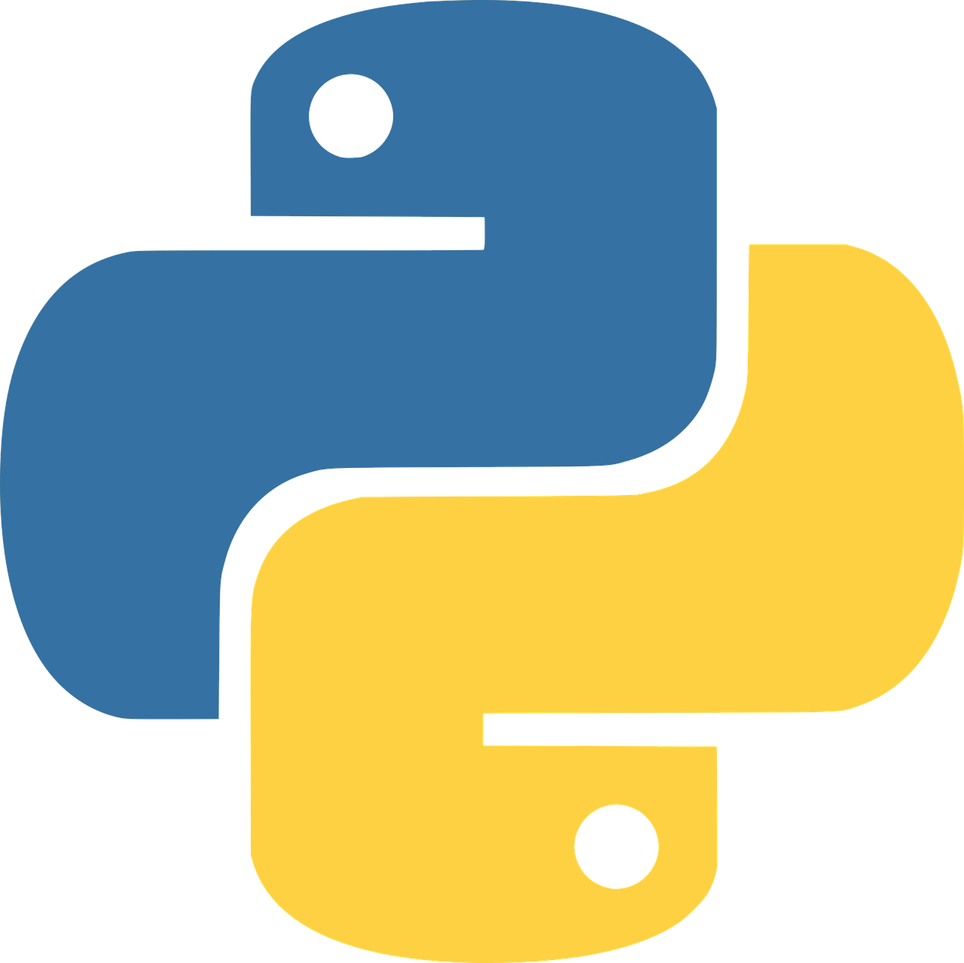
Thank You

